Slide 1
COSC3503 Section 1 Operating Systems Chapter 9 Virtual Memory
Doug Lim

Slide 2
Virtual Memory
To describe the benefits of a virtual memory system
To explain the concepts of demand paging, page-replacement algorithms, and allocation of page frames
To discuss the principle of the working-set model
To examine the relationship between shared memory and memory-mapped files
To explore how kernel memory is managed

Slide 3
Justification for Virtual Memory
Code needs to be in memory to execute, but entire program rarely used
Error code, unusual routines, large data structures
Entire program code not needed at same time
Consider ability to execute partially-loaded program
Program no longer constrained by limits of physical memory
Each program takes less memory while running -> more programs run at the same time
Increased CPU utilization and throughput with no increase in response time or turnaround time
Less I/O needed to load or swap programs into memory -> each user program runs faster

Slide 4
Virtual Memory
Virtual memory – separation of user logical memory from physical memory
Only part of the program needs to be in memory for execution
Logical address space can therefore be much larger than physical address space
Allows address spaces to be shared by several processes
Allows for more efficient process creation
More programs running concurrently
Less I/O needed to load or swap processes

Slide 5
Virtual Address Space
Virtual address space – logical view of how process is stored in memory
Usually start at address 0, contiguous addresses until end of space
Meanwhile, physical memory organized in page frames
MMU must map logical to physical
Virtual memory can be implemented via:
Demand paging
Demand segmentation

Slide 6
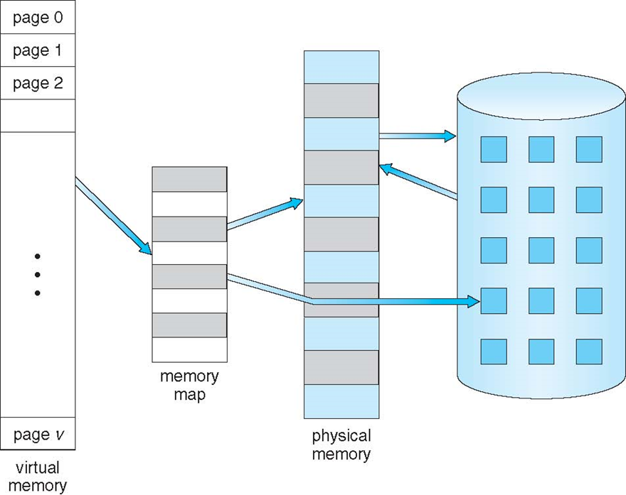
Virtual Memory That is Larger Than Physical Memory

Slide 7
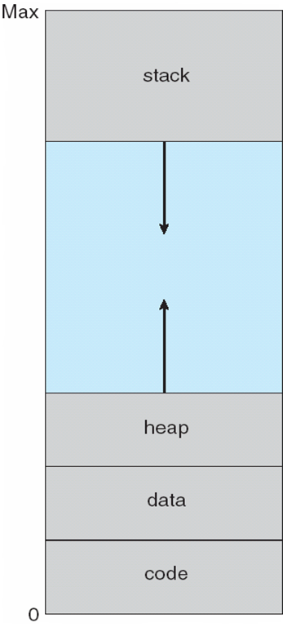
Virtual-address Space
Usually design logical address space for stack to start at Max logical address and grow “down” while heap grows “up”
Maximizes address space use
Unused address space between the two is hole
No physical memory needed until heap or stack grows to a given new page
Enables sparse address spaces with holes left for growth, dynamically linked libraries, etc
System libraries shared via mapping into virtual address space
Shared memory by mapping pages read-write into virtual address space
Pages can be shared during fork(), speeding process creation

Slide 8
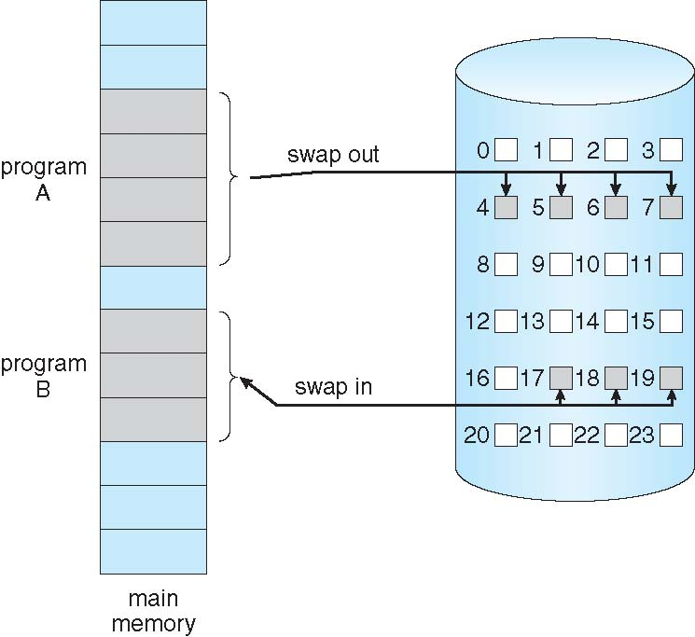
Demand Paging
Could bring entire process into memory at load time
Or bring a page into memory only when it is needed
Less I/O needed, no unnecessary I/O
Less memory needed
Faster response
More users
Similar to paging system with swapping (diagram on right)
Page is needed ⇒ reference to it
invalid reference ⇒ abort
not-in-memory ⇒ bring to memory
Lazy swapper – never swaps a page into memory unless page will be needed
Swapper that deals with pages is a pager

Slide 9
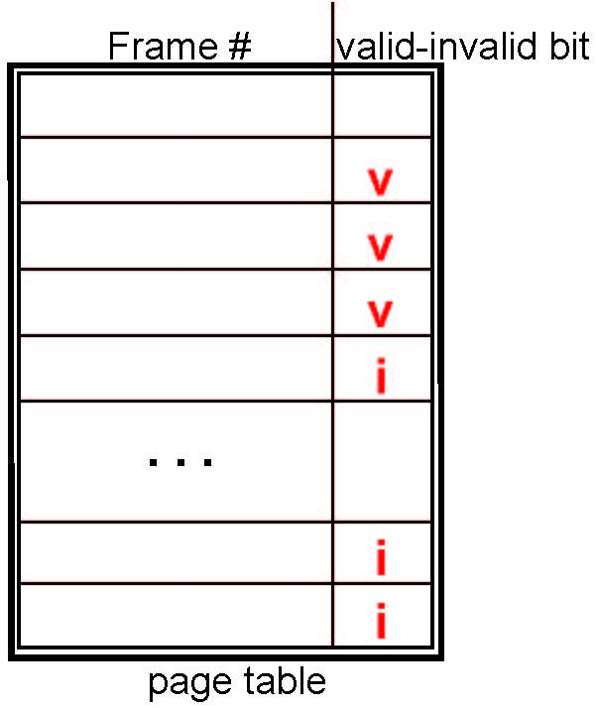
Valid-Invalid Bit
With each page table entry a valid–invalid bit is associated (v => in-memory – memory resident, i => not-in-memory)
Initially valid–invalid bit is set to i on all entries
During MMU address translation, if valid–invalid bit in page table entry is i => page fault

Slide 10
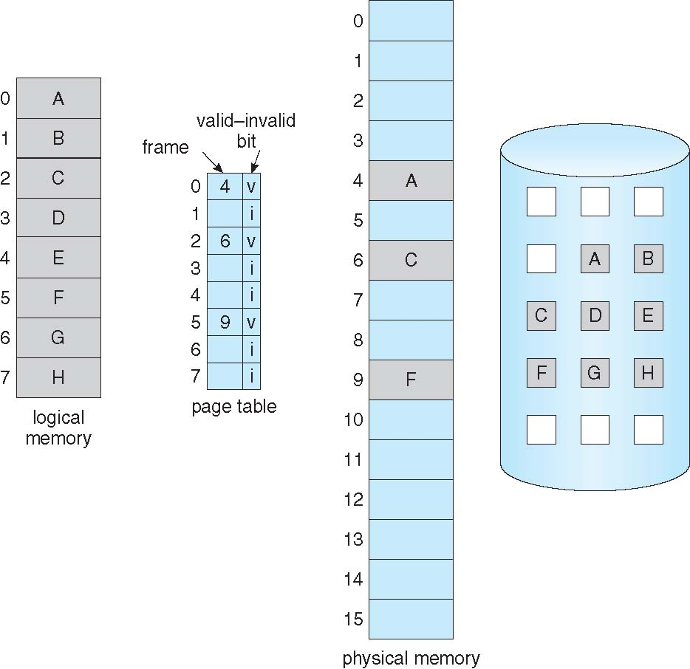
Page Table When Some Pages Are Not in Main Memory

Slide 11
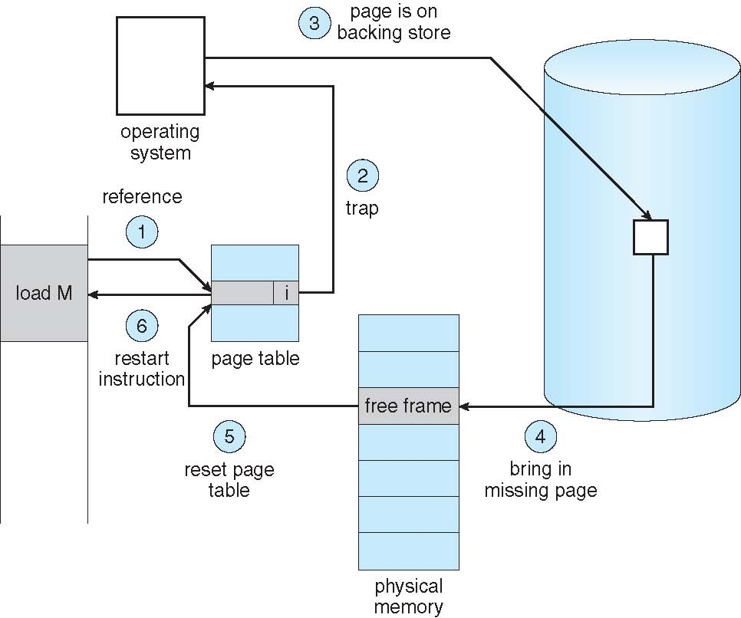
Page Fault
If there is a reference to a page, first reference to that page will trap to operating system:
page fault
Operating system looks at another table to decide:
Invalid reference ⇒ abort
Just not in memory
Find free frame
Swap page into frame via scheduled disk operation
Reset tables to indicate page now in memory Set validation bit = v
Restart the instruction that caused the page fault

Slide 12
What Happens if There is no Free Frame?
Used up by process pages
Also in demand from the kernel, I/O buffers, etc
How much to allocate to each?
Page replacement – find some page in memory, but not really in use, page it out
Algorithm – terminate? swap out? replace the page?
Performance – want an algorithm which will result in minimum number of page faults
Same page may be brought into memory several times

Slide 13
Page Replacement
Prevent over-allocation of memory by modifying page-fault service routine to include page replacement
Use modify (dirty) bit to reduce overhead of page transfers – only modified pages are written to disk
Page replacement completes separation between logical memory and physical memory – large virtual memory can be provided on a smaller physical memory

Slide 14
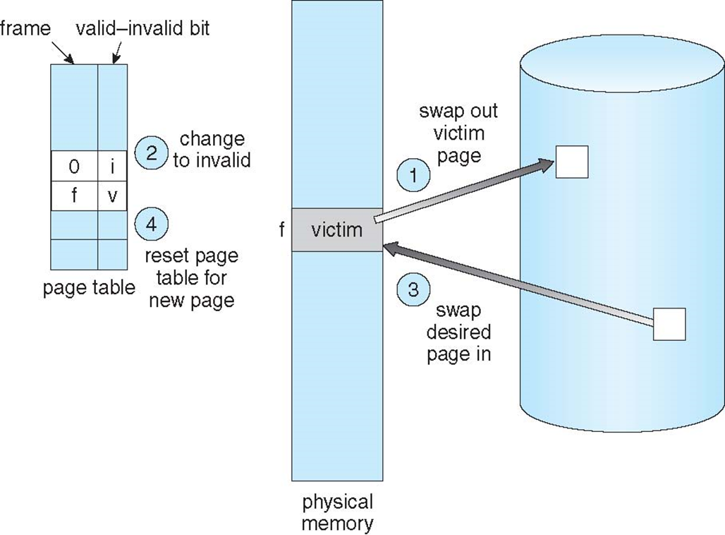
Basic Page Replacement
Find the location of the desired page on disk
Find a free frame: - If there is a free frame, use it - If there is no free frame, use a page replacement algorithm to select a victim frame - Write victim frame to disk if dirty
Bring the desired page into the (newly) free frame; update the page and frame tables
Continue the process by restarting the instruction that caused the trap
Note now potentially 2 page transfers for page fault – increasing the effective access time (EAT).

Slide 15
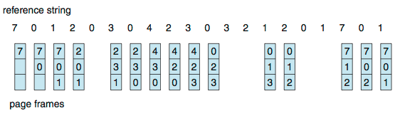
First-In-First-Out (FIFO) Algorithm
Reference string: 7,0,1,2,0,3,0,4,2,3,0,3,0,3,2,1,2,0,1,7,0,1
3 frames (3 pages can be in memory at a time per process)
Can vary by reference string: consider 1,2,3,4,1,2,5,1,2,3,4,5
Adding more frames can cause more page faults!
Belady’s Anomaly
How to track ages of pages?
Just use a FIFO queue

Slide 16
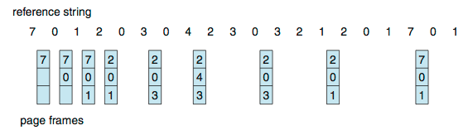
Optimal Algorithm
Replace page that will not be used for longest period of time
9 is optimal for the example
How do you know this?
Can’t read the future
Used for measuring how well your algorithm performs

Slide 17
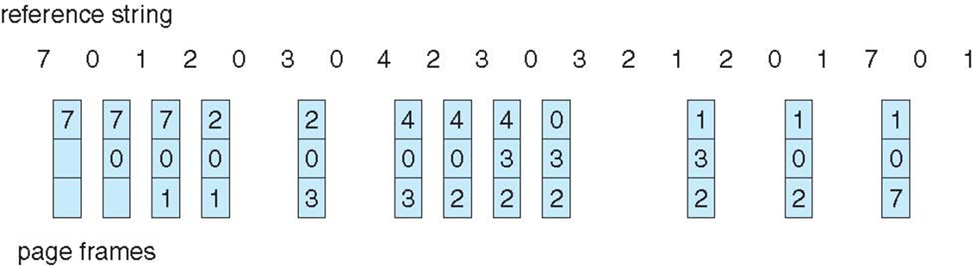
Least Recently Used (LRU) Algorithm
Use past knowledge rather than future
Replace page that has not been used in the most amount of time
Associate time of last use with each page
12 faults – better than FIFO but worse than OPT
Generally good algorithm and frequently used
But how to implement?

Slide 18
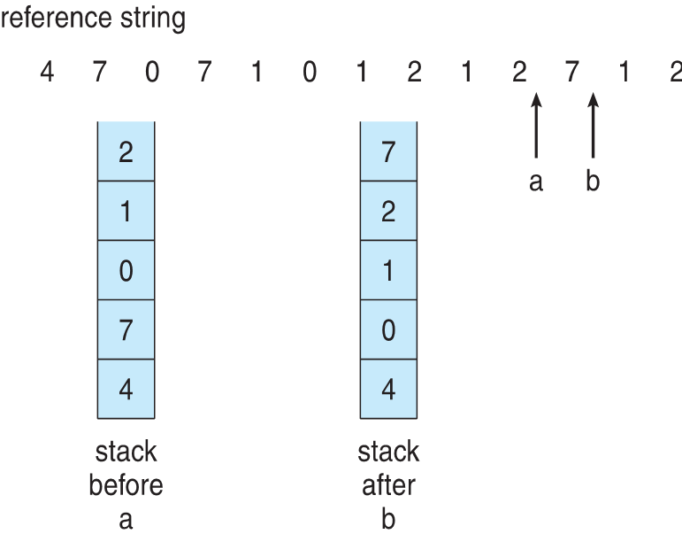
Least Recently Used Implementations
Counter implementation
Every page entry has a counter; every time page is referenced through this entry, copy the clock into the counter
When a page needs to be changed, look at the counters to find smallest value
Search through table needed
Stack implementation
Keep a stack of page numbers in a double link form:
Page referenced:
move it to the top
requires 6 pointers to be changed
But each update more expensive
No search for replacement
LRU and OPT are cases of stack algorithms that don’t have Belady’s Anomaly

Slide 19
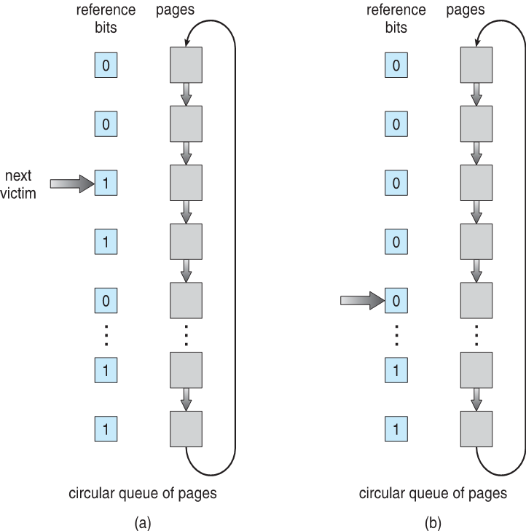
LRU Approximation Algorithms
LRU needs special hardware and still slow
Reference bit
With each page associate a bit, initially = 0
When page is referenced bit set to 1
Replace any with reference bit = 0 (if one exists)
We do not know the order, however
Second-chance algorithm
Generally FIFO, plus hardware-provided reference bit
Clock replacement
If page to be replaced has
Reference bit = 0 -> replace it
reference bit = 1 then:
set reference bit 0, leave page in memory
replace next page, subject to same rules

Slide 20
Enhanced Second-Chance Algorithm
Improve algorithm by using reference bit and modify bit (if available) in concert
Take ordered pair (reference, modify)
(0, 0) neither recently used not modified – best page to replace
(0, 1) not recently used but modified – not quite as good, must write out before replacement
(1, 0) recently used but clean – probably will be used again soon
(1, 1) recently used and modified – probably will be used again soon and need to write out before replacement
When page replacement called for, use the clock scheme but use the four classes replace page in lowest non-empty class
Might need to search circular queue several times

Slide 21
Counting Algorithms
Keep a counter of the number of references that have been made to each page
Not common
Lease Frequently Used (LFU) Algorithm: replaces page with smallest count
Most Frequently Used (MFU) Algorithm: based on the argument that the page with the smallest count was probably just brought in and has yet to be used

Slide 22
Page-Buffering Algorithms
Keep a pool of free frames, always
Then frame available when needed, not found at fault time
Read page into free frame and select victim to evict and add to free pool
When convenient, evict victim
Possibly, keep list of modified pages
When backing store otherwise idle, write pages there and set to non-dirty
Possibly, keep free frame contents intact and note what is in them
If referenced again before reused, no need to load contents again from disk
Generally useful to reduce penalty if wrong victim frame selected

Slide 23
Applications and Page Replacement
All these algorithms have OS guessing about future page access
Some applications have better knowledge – i.e. databases
Memory intensive applications can cause double buffering
OS keeps copy of page in memory as I/O buffer
Application keeps page in memory for its own work
Operating system can be given direct access to the disk, getting out of the way of the applications
Raw disk mode
Bypasses buffering, locking, etc.

Slide 24
Allocation of Frames
Each process needs minimum number of frames
Example: IBM 370 – 6 pages to handle SS MOVE instruction:
instruction is 6 bytes, might span 2 pages
2 pages to handle from
2 pages to handle to
Maximum of course is total frames in the system
Two major allocation schemes
fixed allocation
priority allocation
Many variations

Slide 25
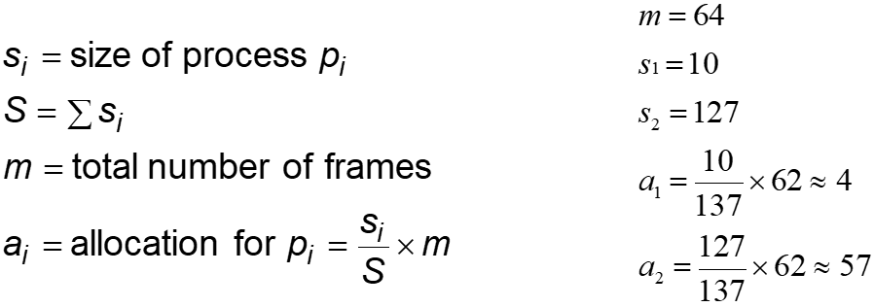
Fixed Allocation
Equal allocation – For example, if there are 100 frames (after allocating frames for the OS) and 5 processes, give each process 20 frames
Keep some as free frame buffer pool
Proportional allocation – Allocate according to the size of process
Dynamic as degree of multiprogramming, process sizes change

Slide 26
Priority Allocation
Use a proportional allocation scheme using priorities rather than size
If process P_{i} generates a page fault,
select for replacement one of its frames
select for replacement a frame from a process with lower priority number

Slide 27
Global vs. Local Allocation
Global replacement – process selects a replacement frame from the set of all frames; one process can take a frame from another
But then process execution time can vary greatly
But greater throughput so more common
Local replacement – each process selects from only its own set of allocated frames
More consistent per-process performance
But possibly underutilized memory

Slide 28
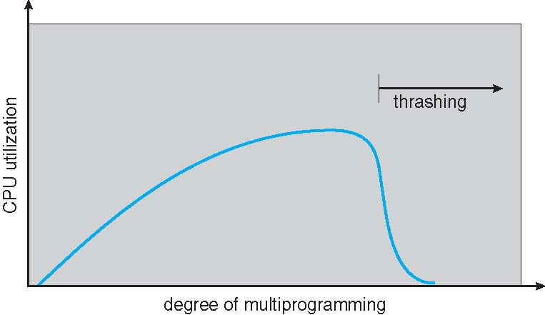
Thrashing
If a process does not have “enough” pages, the page-fault rate is very high
Page fault to get page
Replace existing frame
But quickly need replaced frame back
This leads to:
Low CPU utilization
Operating system thinking that it needs to increase the degree of multiprogramming
Another process added to the system
Thrashing ≡ a process is busy swapping pages in and out

Slide 29
Demand Paging and Thrashing
Why does demand paging work? Locality model
Process migrates from one locality to another
Localities may overlap
Why does thrashing occur? Σ size of locality > total memory size
Limit effects by using local or priority page replacement

Slide 30
Memory-Mapped Files
Memory-mapped file I/O allows file I/O to be treated as routine memory access by mapping a disk block to a page in memory
A file is initially read using demand paging
A page-sized portion of the file is read from the file system into a physical page
Subsequent reads/writes to/from the file are treated as ordinary memory accesses
Simplifies and speeds file access by driving file I/O through memory rather than read() and write() system calls
Also allows several processes to map the same file allowing the pages in memory to be shared
But when does written data make it to disk?
Periodically and / or at file close() time
For example, when the pager scans for dirty pages

Slide 31
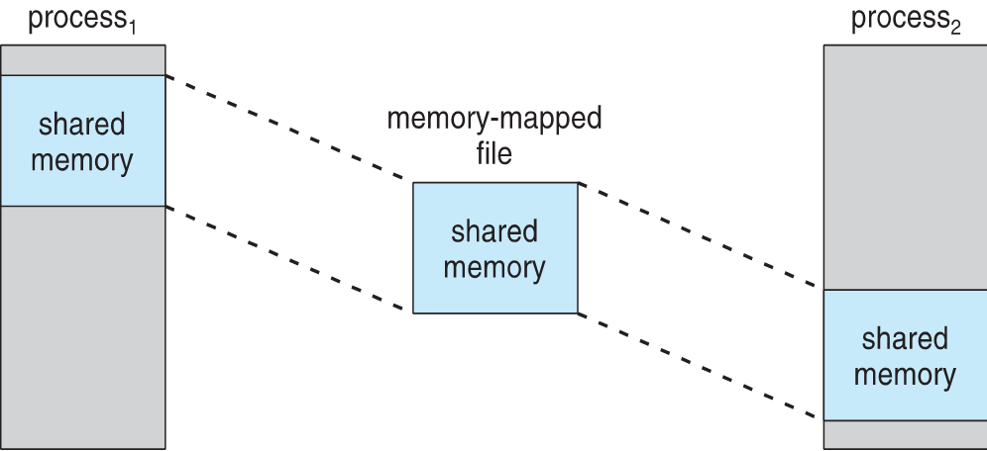
Shared Memory via Memory-Mapped I/O

Slide 32
Allocating Kernel Memory
Treated differently from user memory
Often allocated from a free-memory pool
Kernel requests memory for structures of varying sizes
Some kernel memory needs to be contiguous
I.e. for device I/O

Slide 33
Buddy System
Allocates memory from fixed-size segment consisting of physically-contiguous pages
Memory allocated using power-of-2 allocator
Satisfies requests in units sized as power of 2
Request rounded up to next highest power of 2
When smaller allocation needed than is available, current chunk split into two buddies of next-lower power of 2
Continue until appropriately sized chunk available
For example, assume 256KB chunk available, kernel requests 21KB
Split into A_{L} _{and} A_{R} of 128KB each
One further divided into B_{L} and B_{R} of 64KB
One further into C_{L} and C_{R} of 32KB each – one used to satisfy request
Advantage – quickly coalesce unused chunks into larger chunk
Disadvantage - fragmentation

Slide 34
Slab Allocator
Alternate strategy
Slab is one or more physically contiguous pages
Cache consists of one or more slabs
Single cache for each unique kernel data structure
Each cache filled with objects – instantiations of the data structure
When cache created, filled with objects marked as free
When structures stored, objects marked as used
If slab is full of used objects, next object allocated from empty slab
If no empty slabs, new slab allocated
Benefits include no fragmentation, fast memory request satisfaction

Slide 35
Slab Allocator in Linux
For example process descriptor is of type struct task_struct
Approx 1.7KB of memory
New task -> allocate new struct from cache
Will use existing free struct task_struct
Slab can be in three possible states
Full – all used
Empty – all free
Partial – mix of free and used
Upon request, slab allocator
Uses free struct in partial slab
If none, takes one from empty slab
If no empty slab, create new empty

Slide 36
Slab Variants
Slab started in Solaris, now wide-spread for both kernel mode and user memory in various OSes
Linux 2.2 had SLAB, now has both SLOB and SLUB allocators
SLOB for systems with limited memory
Simple List of Blocks – maintains 3 list objects for small, medium, large objects
SLUB is performance-optimized SLAB removes per-CPU queues, metadata stored in page structure

